Slide 1

A brief introduction to R shiny
Jose Alfaro

Slide 2
Introduction
Shiny is a data visualization tool in R which allows users to interact with graphics and displays data in a unique manner
Applications of Shiny can range from displaying simple graphs and charts to mapping world locations
Works through the use of a user interface and a server function

Slide 3
Shiny Features
Builds useful web applications with no JavaScript required
Works with any environment
Applications are “live” and responsive
Shiny UI may be written in R, HTML, CSS, or JavaScript
Output widgets allow users to create interactive tables, plots, and outputs
Several supporting Shiny packages that tailor to specific needs (leaflet, shinydashboard, shinycssloaders)
Easy to use input/output functions

Slide 4
User interface (UI)
Controls the layout and appearance of the app through
Allows users to add text, images, and other HTML elements to the Shiny app and specify their locations
Also gives users the option to create tabs/panels to organize visuals and widgets

Slide 5
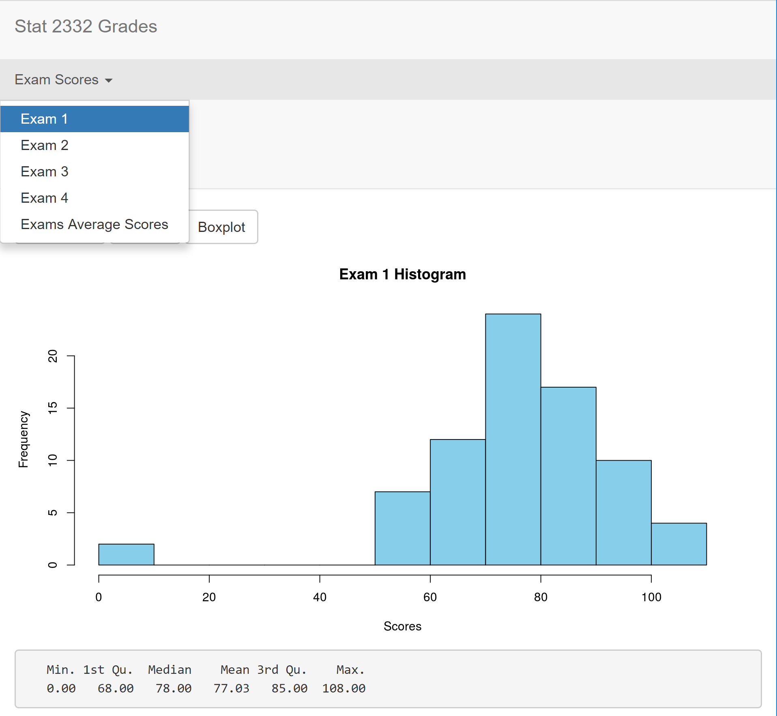
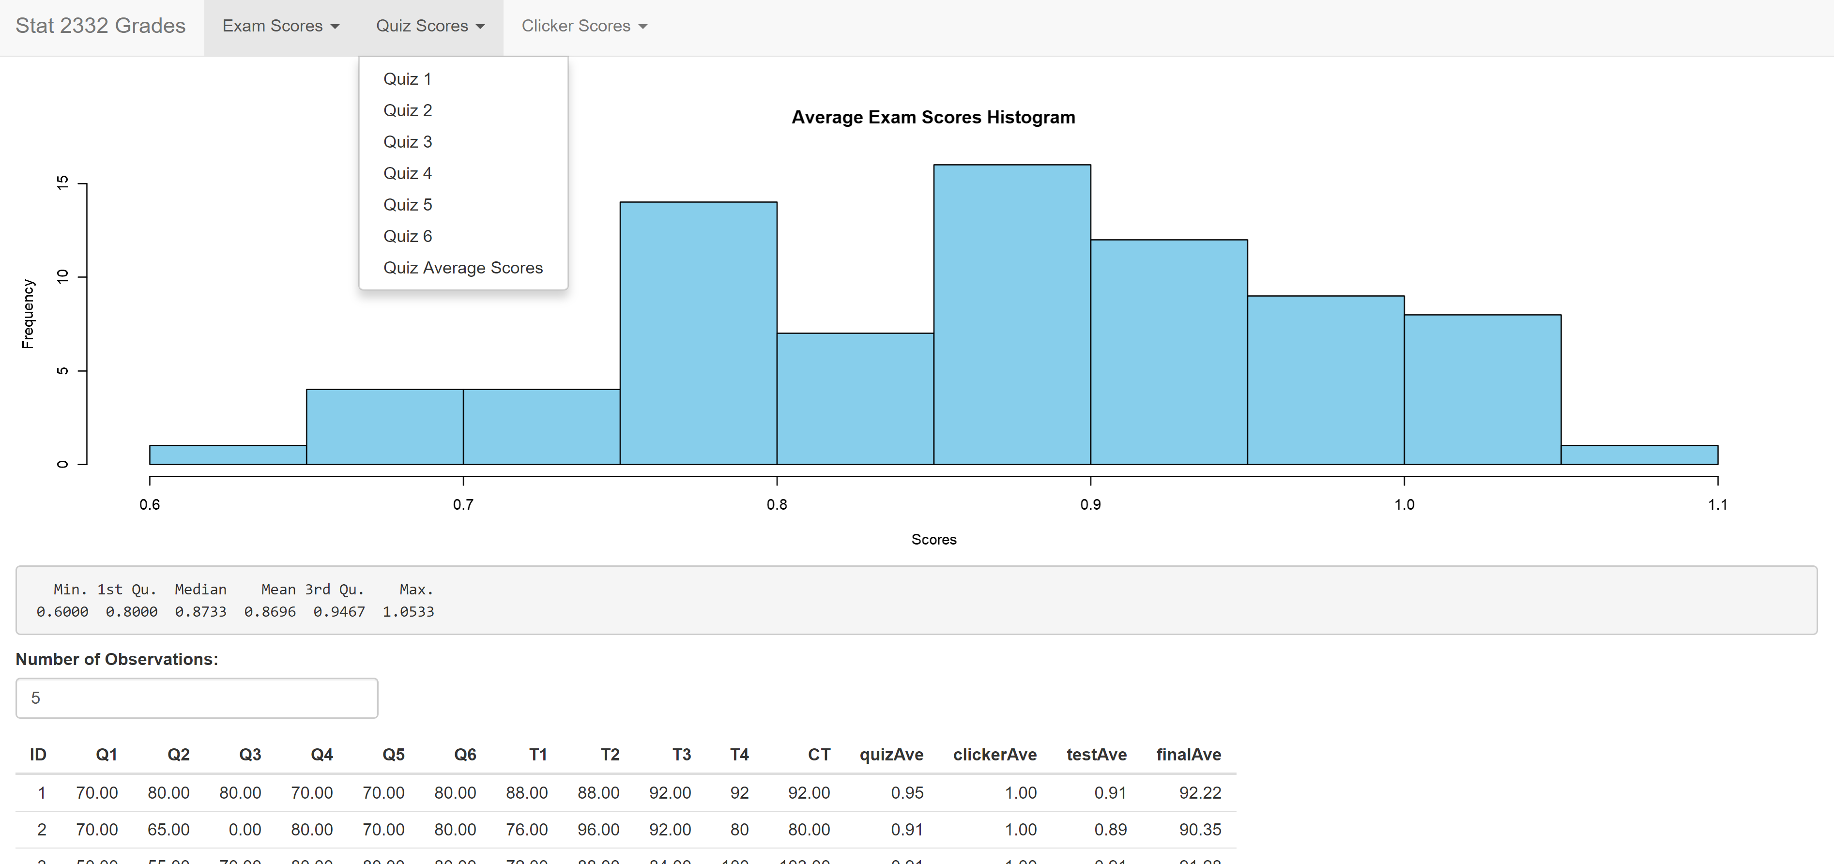
Essential User Interface (UI) Functions
fluidPage() – Function used to adjust the display automatically to the dimensions of a user’s browser window
navbarMenu() – Function used to embed a menu within the app and allows the use of tabs
tabPanel() – Used in conjunction with the TabsetPanel() function in order to create a “tab”.

Slide 6
Server
Contains the instructions that the computer needs to build the app
This is where calculations are processed and stored for use
Each time a user enters a new value into a widget, it is sored in the server function for use, then the app refreshes instantly

Slide 7
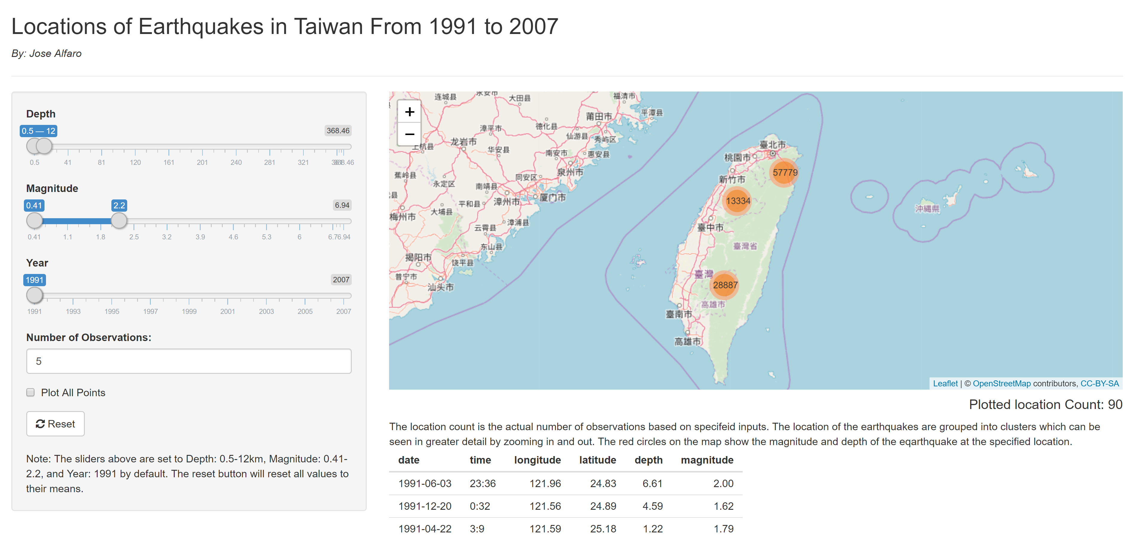
Essential Server Functions
reactiveValues() – Stores reactive values. Similar to initializing variables in C++ or Java.
observeEvent() – Responds to “event-like” reactive inputs. Used whenever a user wants to perform an action in response to an event.
renderPlot() – Renders a reactive plot that is suitable for assigning to an output slot.
renderPrint() – Makes a reactive version of a given function and captures any printed output such that it can be assigned to an output slot.

Slide 8
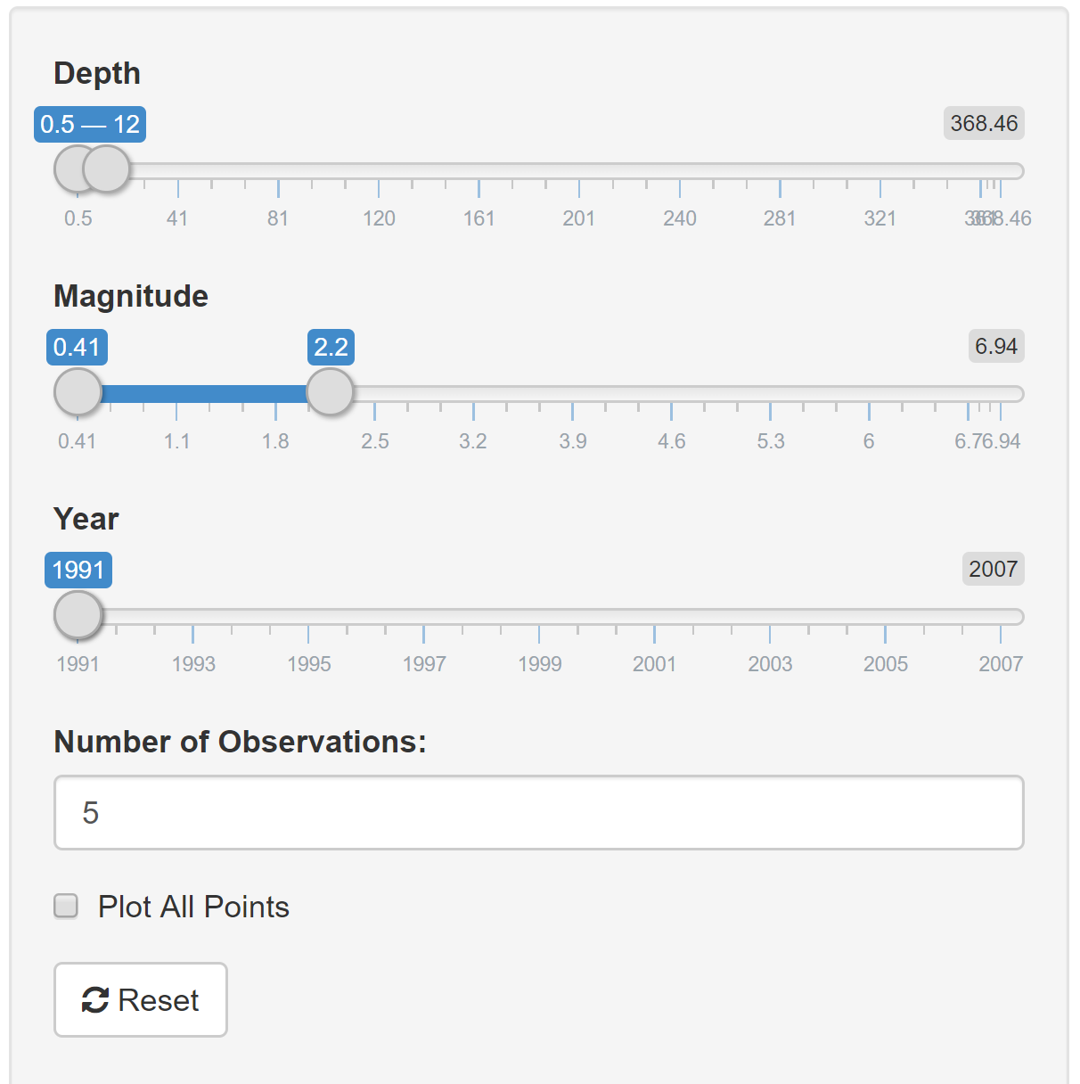
Widget Examples
Action Buttons – Creates a button with an initial value of 0 which increments by one each time it is pressed
Sliders – Used to select single values within a specified range (may be used to create intervals)
Check Boxes – Used to create checkboxes which specify logical values
Numeric Inputs – Creates an input control for entry of numerical values (analogous to text inputs)
File Input – File upload control that can be used to upload files
Note: For a more extensive list of widgets visit (and how to implement them) visit https://shiny.rstudio.com/tutorial/written-tutorial/lesson3/

Slide 9
Shiny App Links
Application #1: Stat 2332 Grade Summary
https://josealfaro.shinyapps.io/Class_Shiny_App/
Application #2: Taiwan Earthquake
https://josealfaro.shinyapps.io/Taiwan_Earthquake_Project/
Note: You may need to press the ctrl key while clicking the links in order to open them.

Slide 10
Homework Questions
What is the purpose of the UI function in a Shiny app?
List three widgets and their uses.

